Slide 1





Course Name object oriented analysis and design
CSC 2210
(Undergraduate)
Software engineering (Undergraduate)
Chapter 4 sequence diagram
Victor Stany Rozario
Assistant Professor
Department of Computer Science, AIUB
Web: https://cs.aiub.edu/profile/stany

Slide 2
Sequence diagram
S.2
Sequence Diagrams are interaction diagrams that detail how operations are carried out and models:
a single scenario executing in the system
communication behavior of individuals exchanging information to accomplish some task.
Sequence diagram—shows interacting individuals along the top and message exchange down the page.
Relation of UML diagrams to other exercises:
CRC cards -> Class diagram
Use cases -> Sequence diagrams

Slide 3
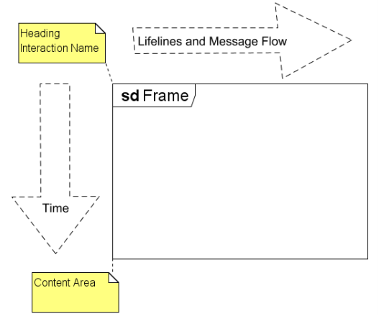
Key parts of sequence diagram
S.3
Frame: a rectangle with a pentagon in the upper left-hand corner called the name compartment.
sd - interaction Identifier is either a simple name or an operation specification as in a class diagram

Slide 4
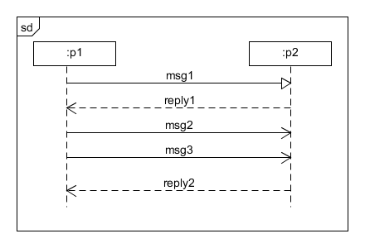
Key parts of Sequence diagram
S.4
Participant: an object or entity (actor, system) that acts in the sequence diagram (rectangle identifier)
Lifelines/Axes: Participating individuals are arrayed across the diagram as lifelines. The dashed line shows the period when an individual exists.
Horizontal: which object/participant is interacting
Vertical: time (down -> forward in time)
Message: communication between participant objects.

Slide 5
Messages and message arrows
S.5
Synchronous—The sender suspends execution until the message is complete (sender waits for reply)
Asynchronous—The sender continues execution after sending the message (no waiting time)
Message return to the sender / instance, object creation

Slide 6
Lifelines
S.6
Participating individuals are arrayed across the diagram as lifelines:
Rectangle containing an identifier
Dashed line extending down the page
The vertical dimension represents time; the dashed line shows the period when an individual exists.

Slide 7
Lifeline Creation and Destruction
S.7
An new object appears at the point it is created.
Not clear from UML specification
A destroyed object has a truncated lifeline ending in an X.
Persisting objects have lifelines that run the length of the diagram.

Slide 8
Lifelines Example
S.8

Slide 9
Lifeline Identifier Format
S.9
name[ selector ] : typeName
name—simple name or “self”; optional
selector—expression picking out an individual from a collection
Format not specified in UML
Optional; if omitted, so are the brackets
typeName—Type of the individual
Format not specified in UML
Optional; if omitted, so is the colon
Either name, typeName, or both must appear

Slide 10
Lifeline Identifier Examples
S.10
name[ selector ] : typeName
player[i] : Player
player[i]
: Player
board

Slide 11
Sequence diagram heuristics
S.11
Put the sender of the first message leftmost.
Put pairs of individuals that interact heavily next to one another.
Position individuals to make message arrows as short as possible.
Position individuals to make message arrows go from left to right.

Slide 12
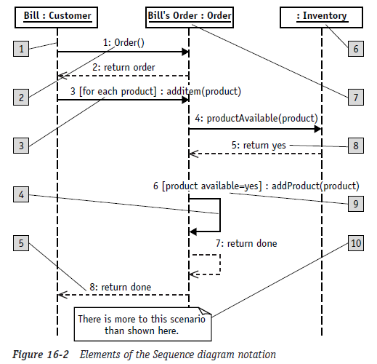
Sequence diagram elements
S.12
The reference numbers
on the figure denotes:
Object lifeline
Message/Stimulus
Iteration
Self-reference
Return
Anonymous object
Object name
Sequence number
Condition
Basic comment
Self Execution

Slide 13
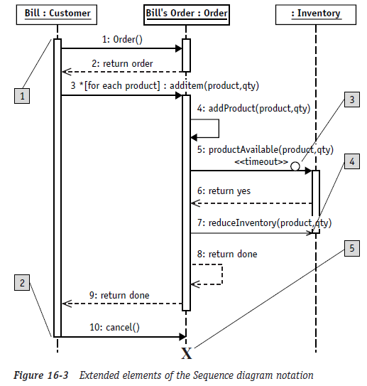
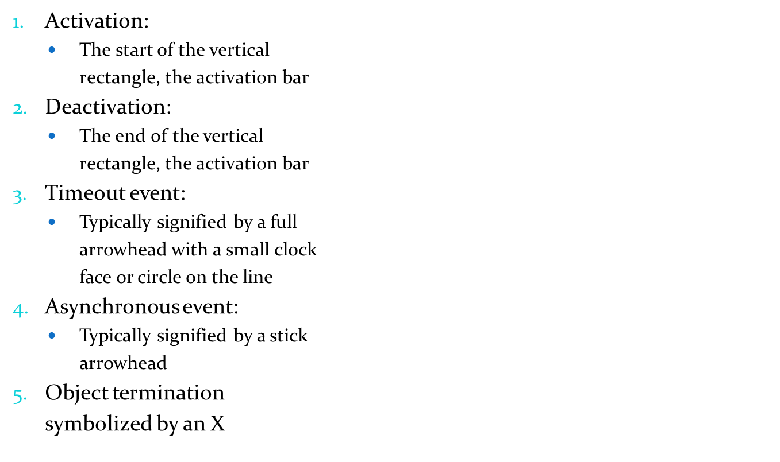
Elements (extended)
S.13

Slide 14
Sequence Diagram 2.0
S.14
Structured Control Operators
‘OPT’: Optional
‘ALT’: Alternate
‘PAR’: Parallel
‘Loop’: Iterative
‘Ref’: Reference
There are many operators, but these are most common

Slide 15
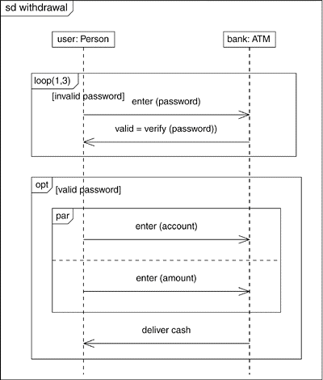
Sequence Diagram with Structured Controls
S.15

Slide 16
Execution occurrence
S.16
An operation is executing when some process is running its code.
An operation is suspended when it sends a synchronous message and is waiting for it to return.
An operation is active when it is executing or suspended. The period when an object is active can be shown using an execution occurrence (Thin white or grey rectangle over lifeline dashed line)

Slide 17
Execution Occurrence Example
S.17

Slide 18
Case studies
S.18
Case 1
In a withdrawal transaction of an ATM Machine system the customer inserts his ATM card in the machine. The machine then verifies the customer authentication using the information provided in customer account. After successful verification the machine takes withdrawal request from the customer and checks whether the request is valid or not. A valid request is carried out by the machine. In case of unsuccessful verification the customer request is denied.

Slide 19
Case studies
S.19
Case 2
In a library management system of a university a member can place a request to book a journal to the librarian. Before the librarian can complete the booking the member has to be verified of his status whether he is allowed to borrow journals or not. The journal then has to be located whether it is in the campus where the request was made or it is in a different campus. If the journal is in a different campus the librarian makes a request for the journal to be sent at the requested campus. The librarian then informs the member about the time required for the journal to reach and completes the booking.

Slide 20
Case studies
S.20
Case 3
A doctor includes the instruction in the patient advice when a patient requires a bed or room in the hospital. The advice is then passed to the office clerk. The office clerk checks the present booking database to get the available room and bed list. Facilities of the rooms and the beds are then extracted from the room list. Available room and bed numbers and facilities are sent to the patient. The patient chooses a room or bed and then the office clerk writes patientid, room or bed no, doctorid and doctor advice in the booking database. Finally a copy of the admission is sent to the associated nurse and a copy is given to the patient

Slide 21
Case studies
S.21
Case 4
When an air cooler starts, the control switch sends signal to the blower fan to start at the level that is already set in the control switch. Then the control switch sends the level of temperature to the sensor. The sensor senses the outside temperature by sending a request to the thermostat and if the outside temperature is higher then the level sent by the control switch, the sensor send signal to the compressor to switch on. When the sensor outside temperature goes down to the set level, the thermostat sends signal to the sensor and the sensor in turn sends signal to the compressor to switch off. The process keeps on running in a cycle as long as the air cooler stays on.

Slide 22
references
S.22
Booch, G., Rumbaugh, J. & Jacobson, I. (2005). The unified modeling language user guide. Pearson Education India.

